Slide 1
DevSecOps & Automation- 2023

Slide 2
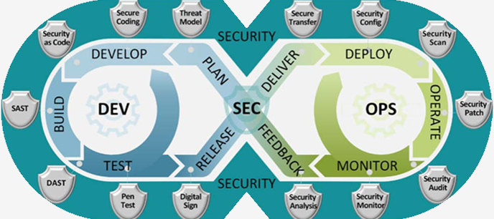
DevSecOps 2023
Implement Lean practices through DSO maturity coverage for 70% of high ROI products (~120 applications)and achieve overall DSO maturity level of 3+ . Complete assessments & re- assessments for 180+ applications for benchmarking and adding value to applications.
OKR
Why DevSecOps?
DevSecOps practices and tools enable increased operating speed and flexibility, release-on-demand, and first-time quality of secure-by-design applications.
DevSecOps bridges the gaps between development, security, and operations - continuous learning, collaboration, and security integration will yield shorter feedback loops, fewer bottlenecks, and fewer vulnerabilities.

Slide 3
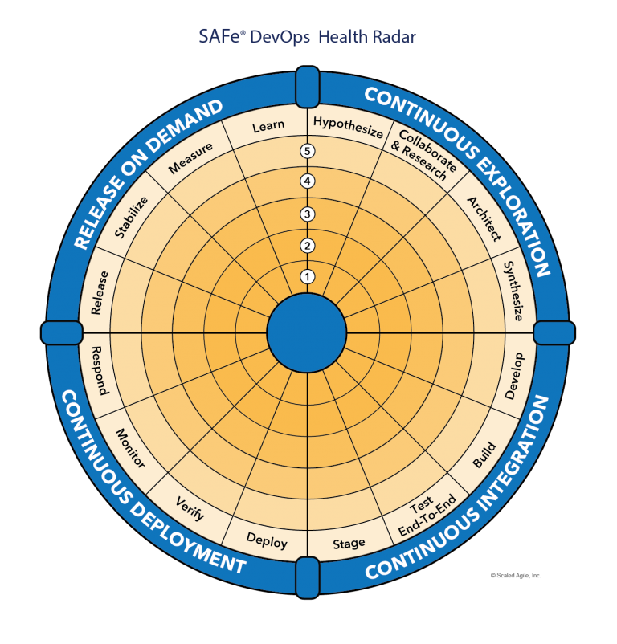
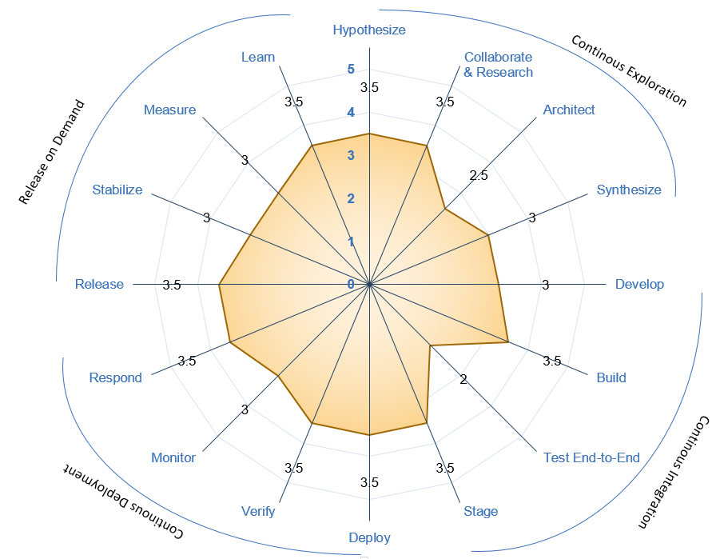





DevSecOps Maturity
Maturity Level | Stage | Stage Adoption | % of Adoption
Level 1 (Sit) | Initial | Yet to Start; Traditional environment and mindset | <=20%
Level 2 (Crawl) | Emerging | Beginning of change and agility; Initiated automation; | 21%-50%
Level 3 (Walk) | Practicing | Started Practicing; Transformation happening with defined process and automation | 51%-70%
Level 4 (Run) | Optimizing | High in Adoption ;Optimizing the existing practices and following Continuous improvement | 71%-90%
Level 5 (Fly) | Leading | Being a leader in adoption; | >90%
Recommended minimal level for DSO Adoption
Maturity Level
Sit
Level 1
Crawl
Level 2
Walk
Level 3
Run
Level 4
Fly
Level 5
1- Low & 5-High Maturity

Slide 4
Why Implement DevSecOps?

Slide 5
Process

Slide 6
Success Stories

Slide 7
Progress
On Track
Watch Item
Off Track
2023 OKR Targets
Q1
Q2
Target
Completed
Target
Completed
Complete DSO Assessments for new applications 120 Apps
30
34
30
8
Implementation roadmap for Applications that have completed assessments- 90 Apps
30
30
2
28
Roadmap implementation , Re-Assessment & ROI calculation for 15% Apps with roadmap created: - 40 apps
10
0
10
0
*DSO Improvements pending
*DSO Improvements pending
Maturity improvement and maintain Score 3.0+
Maturity Score 3
Maturity Score 3

Slide 8
Look Ahead

Slide 9
Resources
Training:
https://devsecops.web.boeing.com/trainings.html
https://insite.web.boeing.com/culture/viewMedia.do?mediaId=428840
Insite: DevSecOps related video series
Degreed: https://degreed.com/pathway/mpl66o5r9d/pathway
Oreilly: https://learning.oreilly.com/library/view/the-devops-handbook/9781457191381/
Support
In case of any queries interested teams can register themselves through EMC (check for the session with the name “DevSecOps Office Hours (India)”).
For Product Teams in US, Click Here to block your slot
For Product Teams in India, Click Here to block your slot
DSO Support Systems | Description | URL
ATOMS | Platform to onboard to some of the commonly used tools like Coverity, Netsparker, SonarQube | https://atoms.web.boeing.com/home
ATOMS-CI | Saves your team time by generating an automated continuous integration pipeline and integrating different tools | https://atoms-ci.web.boeing.com/ci
DevSecOps | Official DevSecOps website | https://devsecops.web.boeing.com/index.html
Boeing Application Security - Docs | Official Infosec website | https://dev-sec-docs.web.boeing.com
AppDynamics | Monitoring tool documentation | https://itms.pages.boeing.com/wiki/appdynamics/
Enablement kit | Architecture Checklist to improve maturity | https://devsecops.web.boeing.com/assessment/enablementKit.html
DSO Mattermost channel | Join this channel for any questions/updates | https://mattermost.web.boeing.com/dso/channels/town-square
DSO Consultation | Connect with the experts | DL DSO Consulting
DSO COE InSite Group | Join this group for any questions/updates | https://insite.web.boeing.com/culture/viewGroup.do?groupId=168061
DevSecOps Video Library | Videos on different implementation | https://insite.web.boeing.com/culture/displayGroupMedia.do?groupId=168061

Slide 10
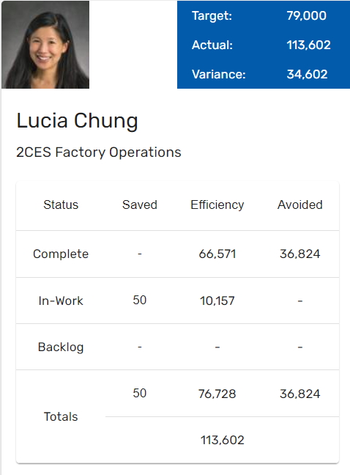
Automation Status - 2023
OKR
Implement automation capabilities through out the applications and achieve 80000 automation hours

Slide 11
Look Ahead

Slide 12
Team

Slide 13
Thank You

